Slide 1
Knowledge Graph Creation Group: Furqan Shoukat – 241ADM029 Alish Vankawala – 241ADM044 Ibtisam Akram – 241ADM036

Slide 2
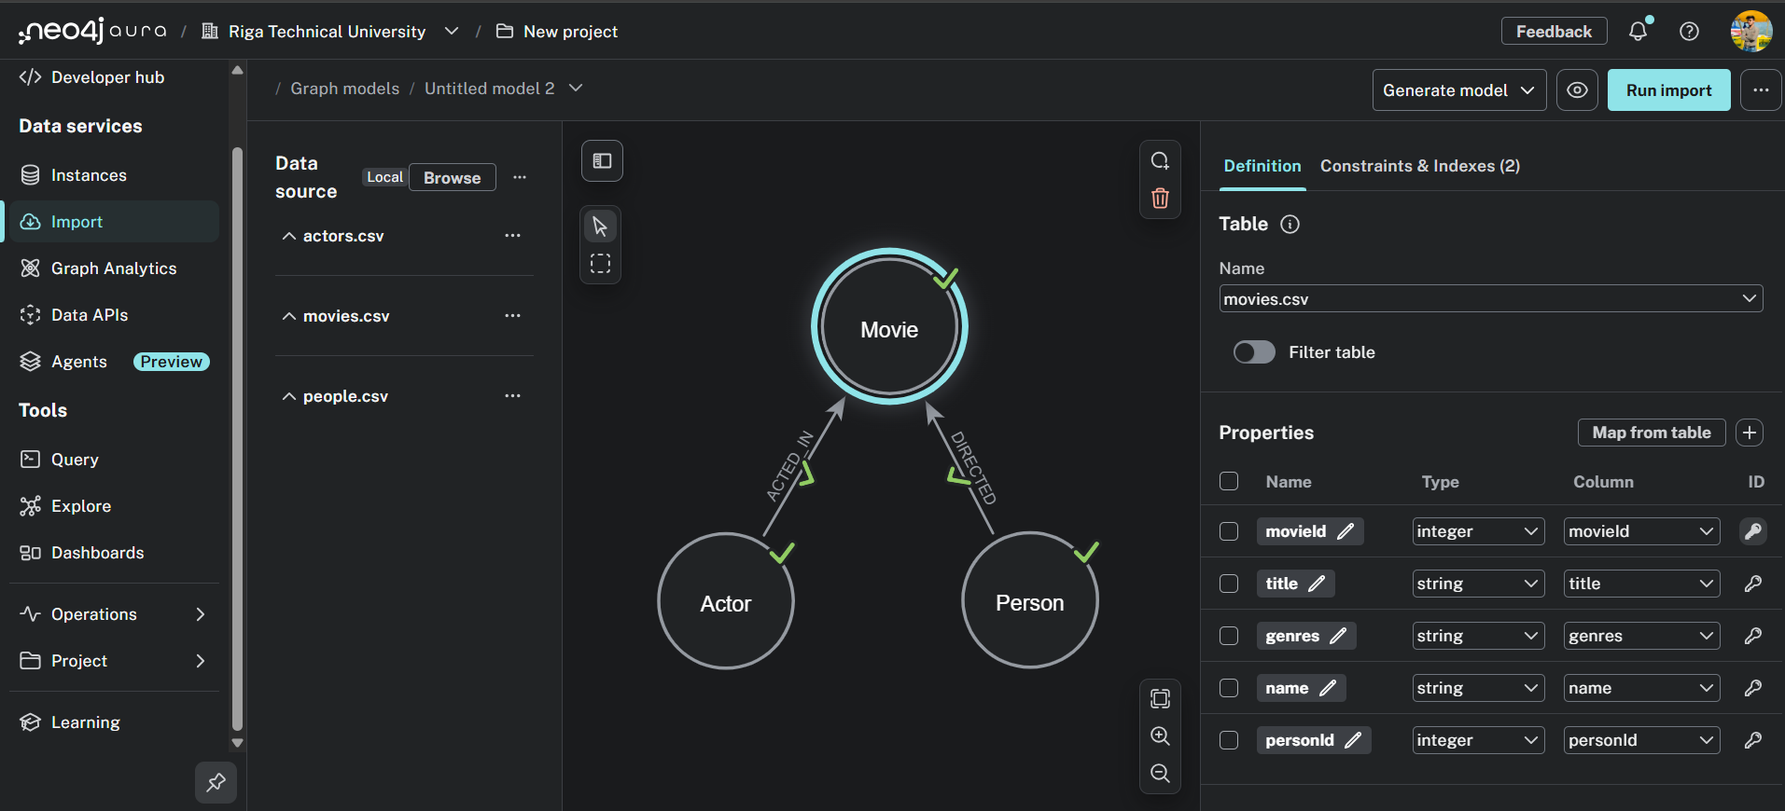
Knowledge Graph

Slide 3
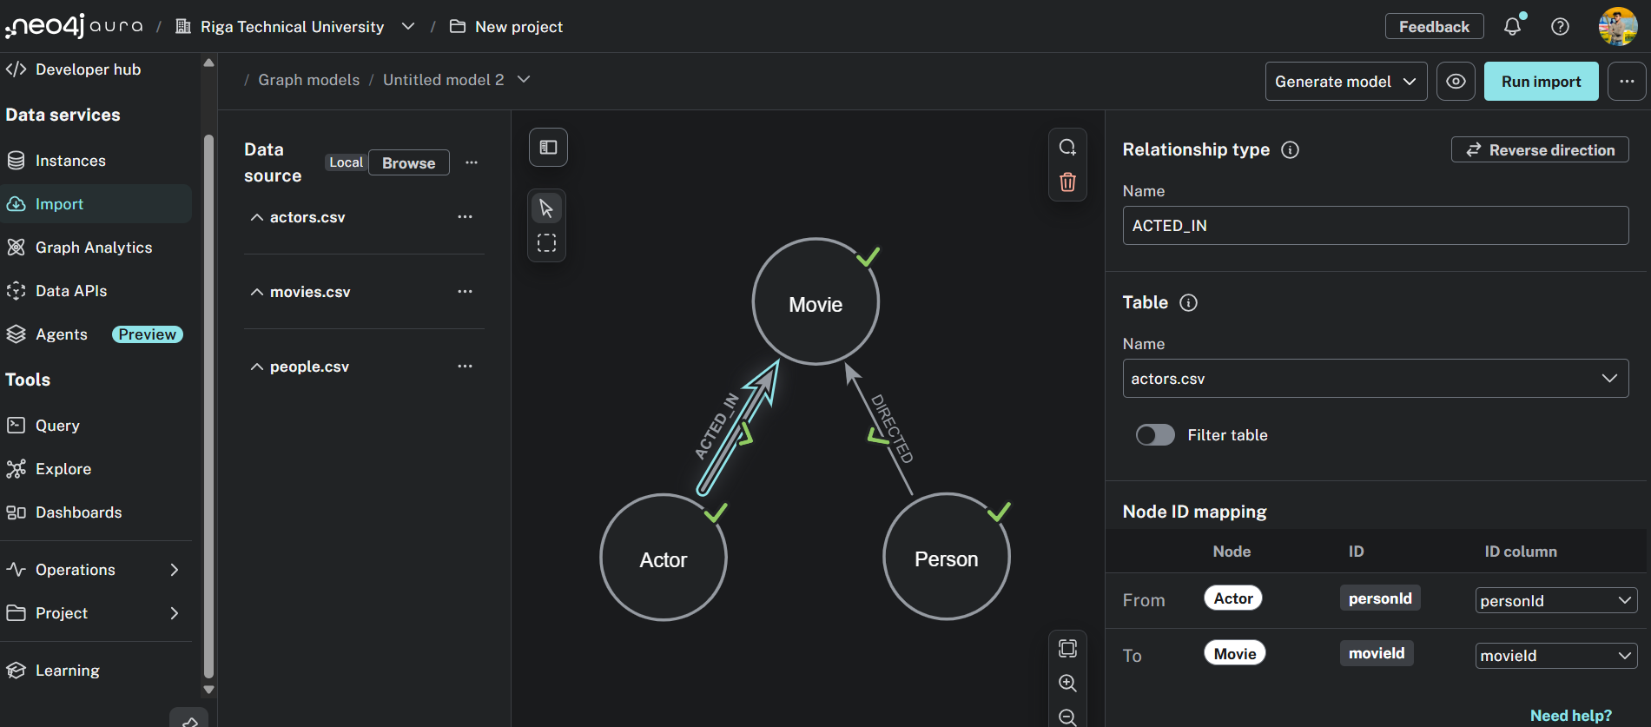
Relationship

Slide 4
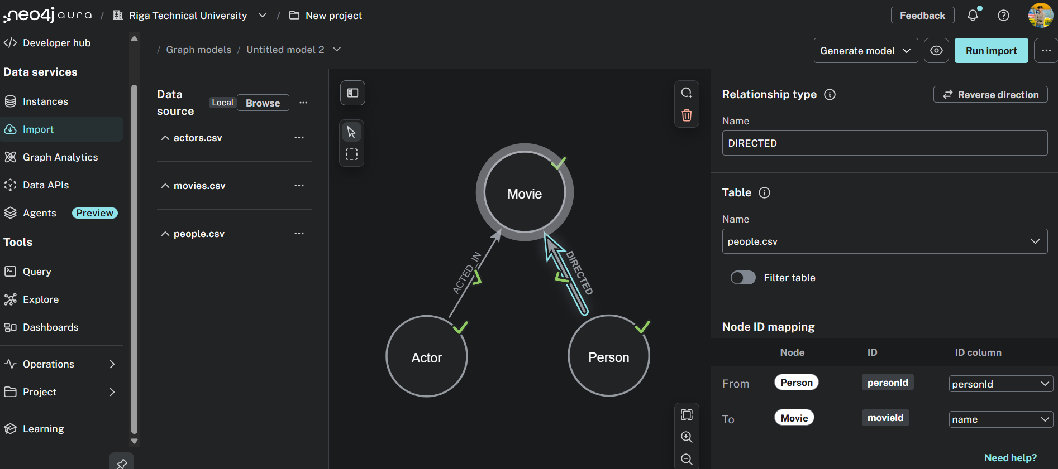
Relationship

Slide 5
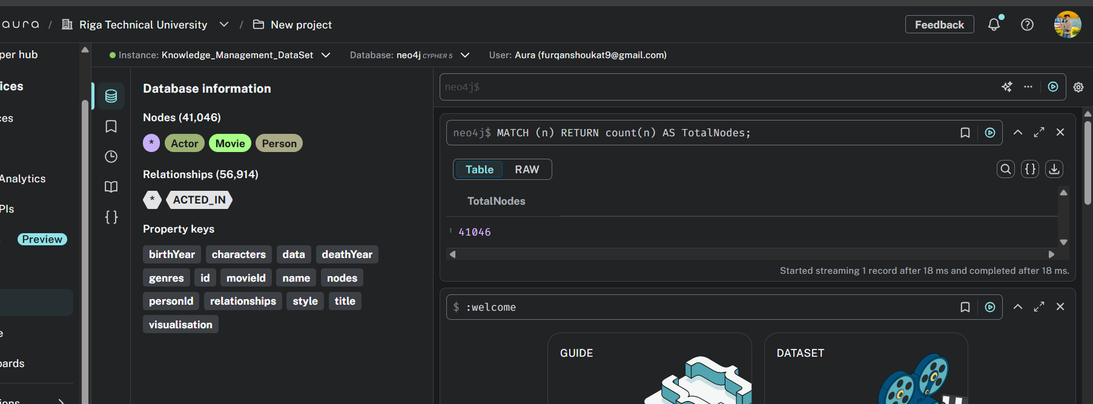
Query 1:
MATCH (n) RETURN count(n) AS TotalNodes;

Slide 6
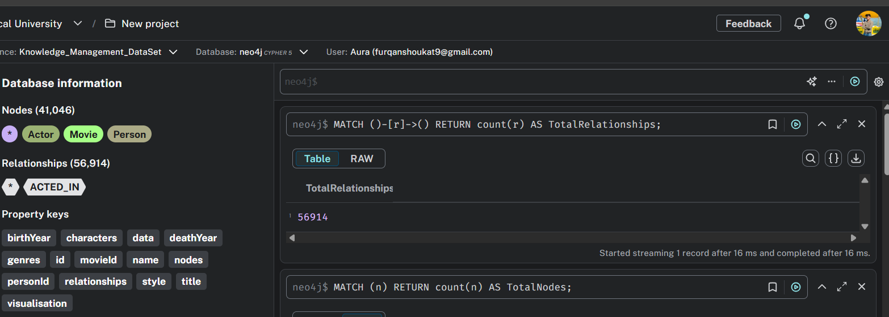
Query 2:
MATCH ()-[r]->() RETURN count(r) AS TotalRelationships;

Slide 7
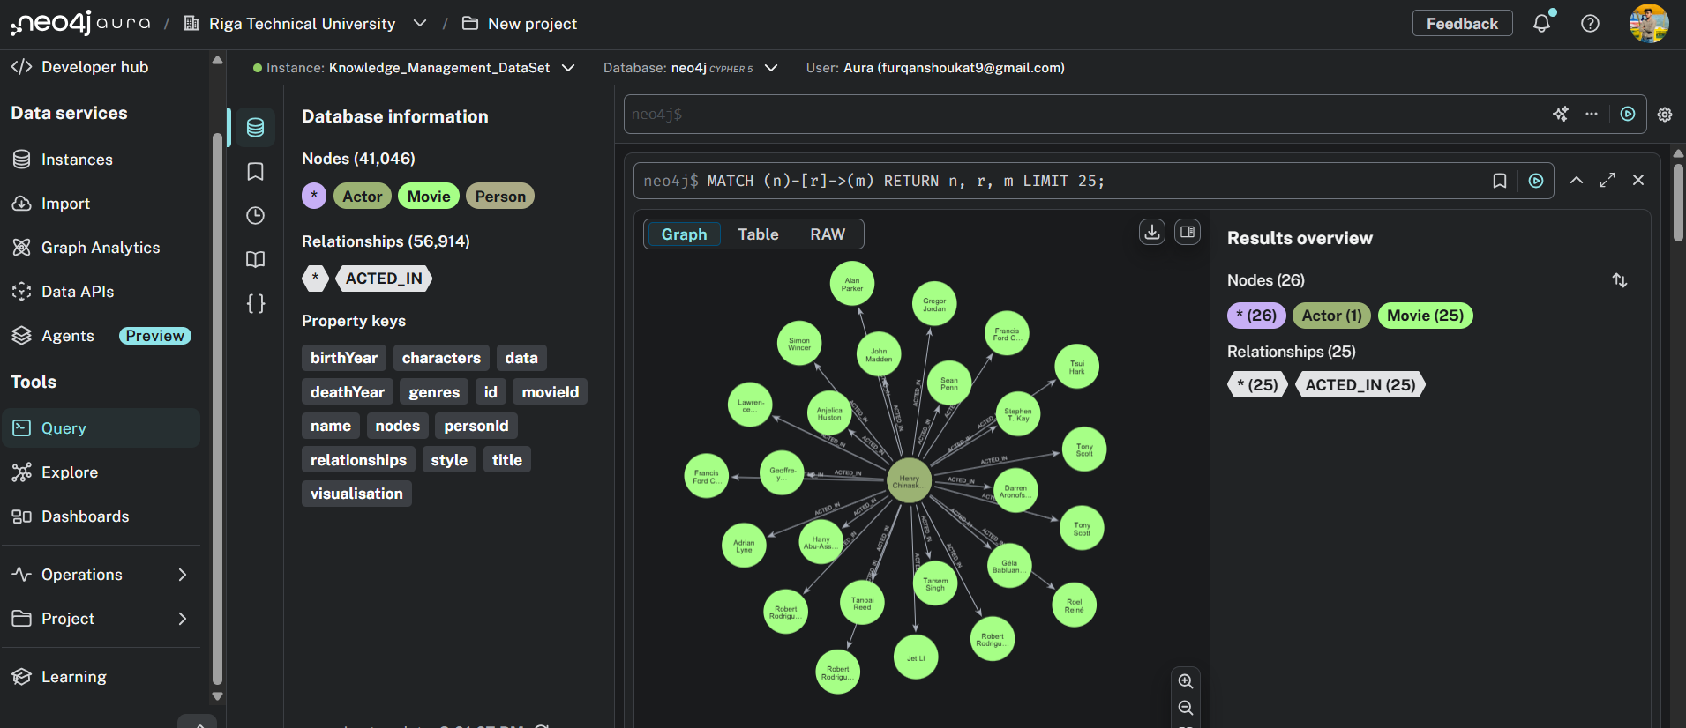
Query 3:
MATCH (n)-[r]->(m)RETURN n, r, mLIMIT 25;

Slide 8
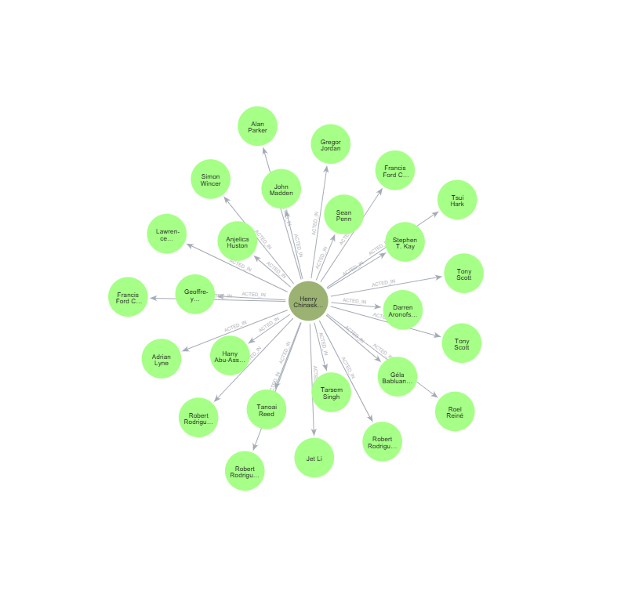

Slide 9
Thank you!
GitHub Repository: https://github.com/Furqan-Shoukat/AuraDB-Knowledge-Graph-Creation

